Slide 1
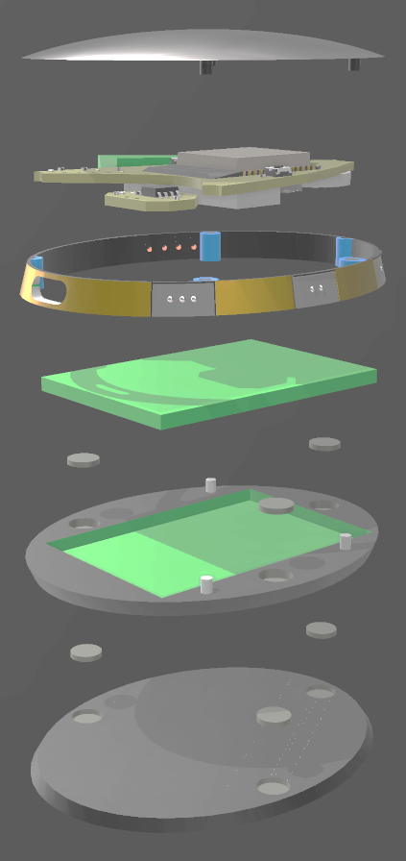
ComBadge Manual
COMPACT
MOBILE
v0.1a
OPEN-SOURCE

Slide 2
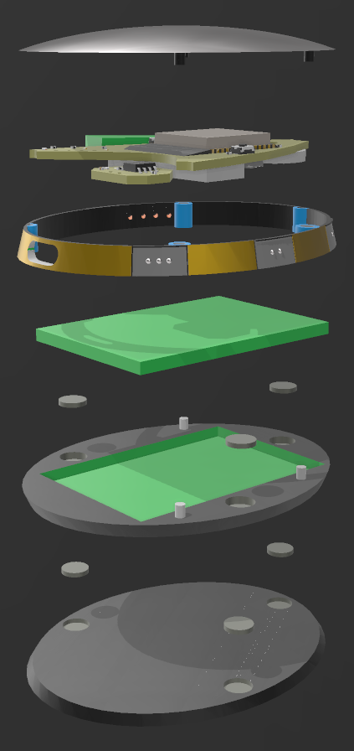
Silver Coated
3D Printed Main
Touch Panel
ESP32 PCB Featuring:
- INMP441
- 3.3v 600mA
Regulator
- I2S Sound
- 8Ω Speaker
- TP4056 LiPo
Charger
Exploded View:
USB-C
Charge Port
Gold Plated
3D Printed Structure
1000mAh
LiPo Battery
Recessed
Rear Panel
Neodymium Magnets
Undershirt Magnetic Holder

Slide 3
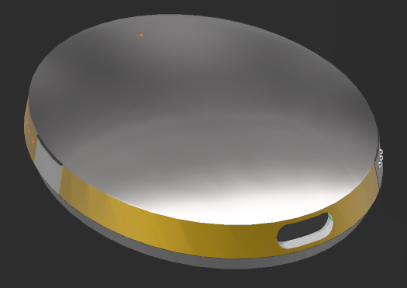
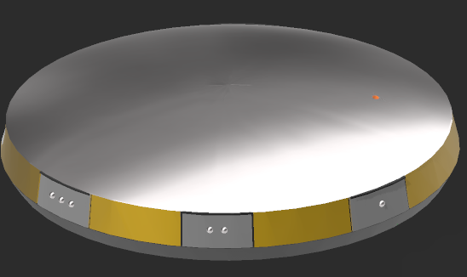
Interaction:
_Microphone Input
Main Capacitive Touch Panel_
_Speaker Output
USB-C Charging Port_
(NOT Data)
_Secondary Capacitive Touch Pads
To use:
Main Panel:
Tap to activate Listening Mode where the ComBadge will listen for Spoken Commands. - See Commands.
Second Tap cancels and exits current Mode or ends current Call.
Secondary Touch Pads:
Tap to activate corresponding function. - See Secondary Functions.

Slide 4
Commands:
After a Tap on the Capacitive Touch Panel, counter of 5 seconds will begin, where Listening mode is active.
During Listening Mode speak one of the following to activate its function:
Command | Function
Call <NAME> | Calls Contact with matching name. AI hears command, sends request for Matching <BADGE-ID> from local Contacts list, Connects both Badges to a Private Channel.
Time, Date etc | AI hears command and Responds with requested information.
Add Contact | Adds new Local Contact. * AI sends request for <NAME> of contact. Speak the name you will say to Call them. AI then requests <BADGE-ID>. Speak <BADGE-ID> (found in Wireless AP & rear of Badge). Both get saved to local Badge Storage.
Translate to <LANGUAGE> | AI begins recording, translates and plays back the translation. *
* Not all features are currently enabled

Slide 5
Secondary Touch Button Functions:
Button | Function
Middle Right | Function-Lock Key (SHIFT) Used to ensure no accidental activation of other buttons (HOLD to use)
Top Left | Mute
Middle Left | On-Demand Wireless Configuration Access Point
Bottom Left | User Programable Function Default: Speak Time
Top Left
Middle Right
Middle Left
(Front view)
Bottom Left

